Slide 1



Real-time Chatting
By Redis , Nodejs , socket.io

Slide 2
Real-time Chatting
I. Basic Knowledge
Redis
NodeJS
Socket.io
II. Real-time Chatting
Prepare environment
Implementation

Slide 3
1. Redis
In-memory data structure used as Database, Cache, Message broker
Key-value stored
Written in C
Open source (BSD licensed)

Slide 4
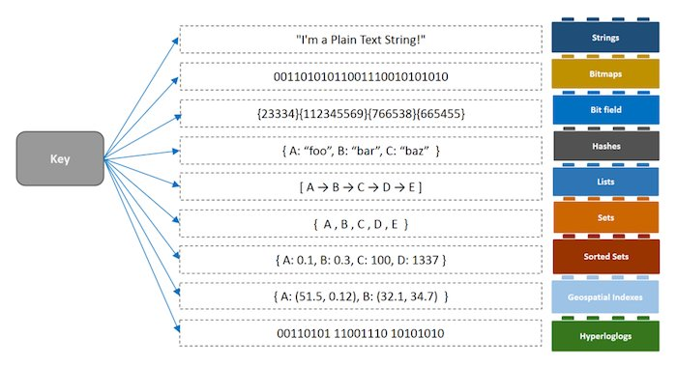
1. Redis
Data Structure

Slide 5
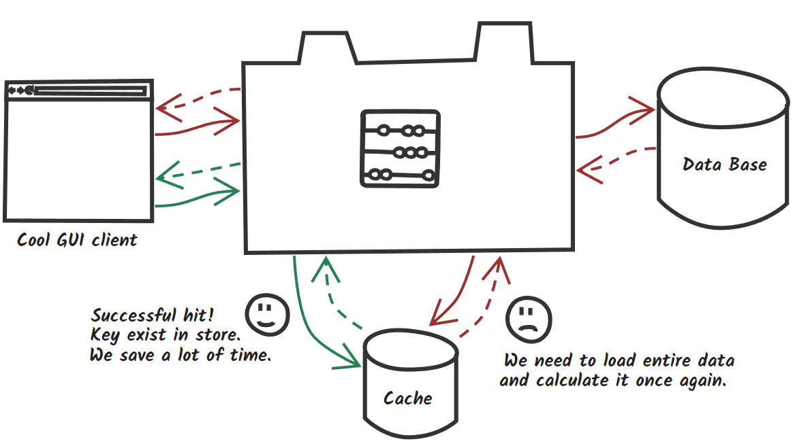
1. Redis
Cache

Slide 6
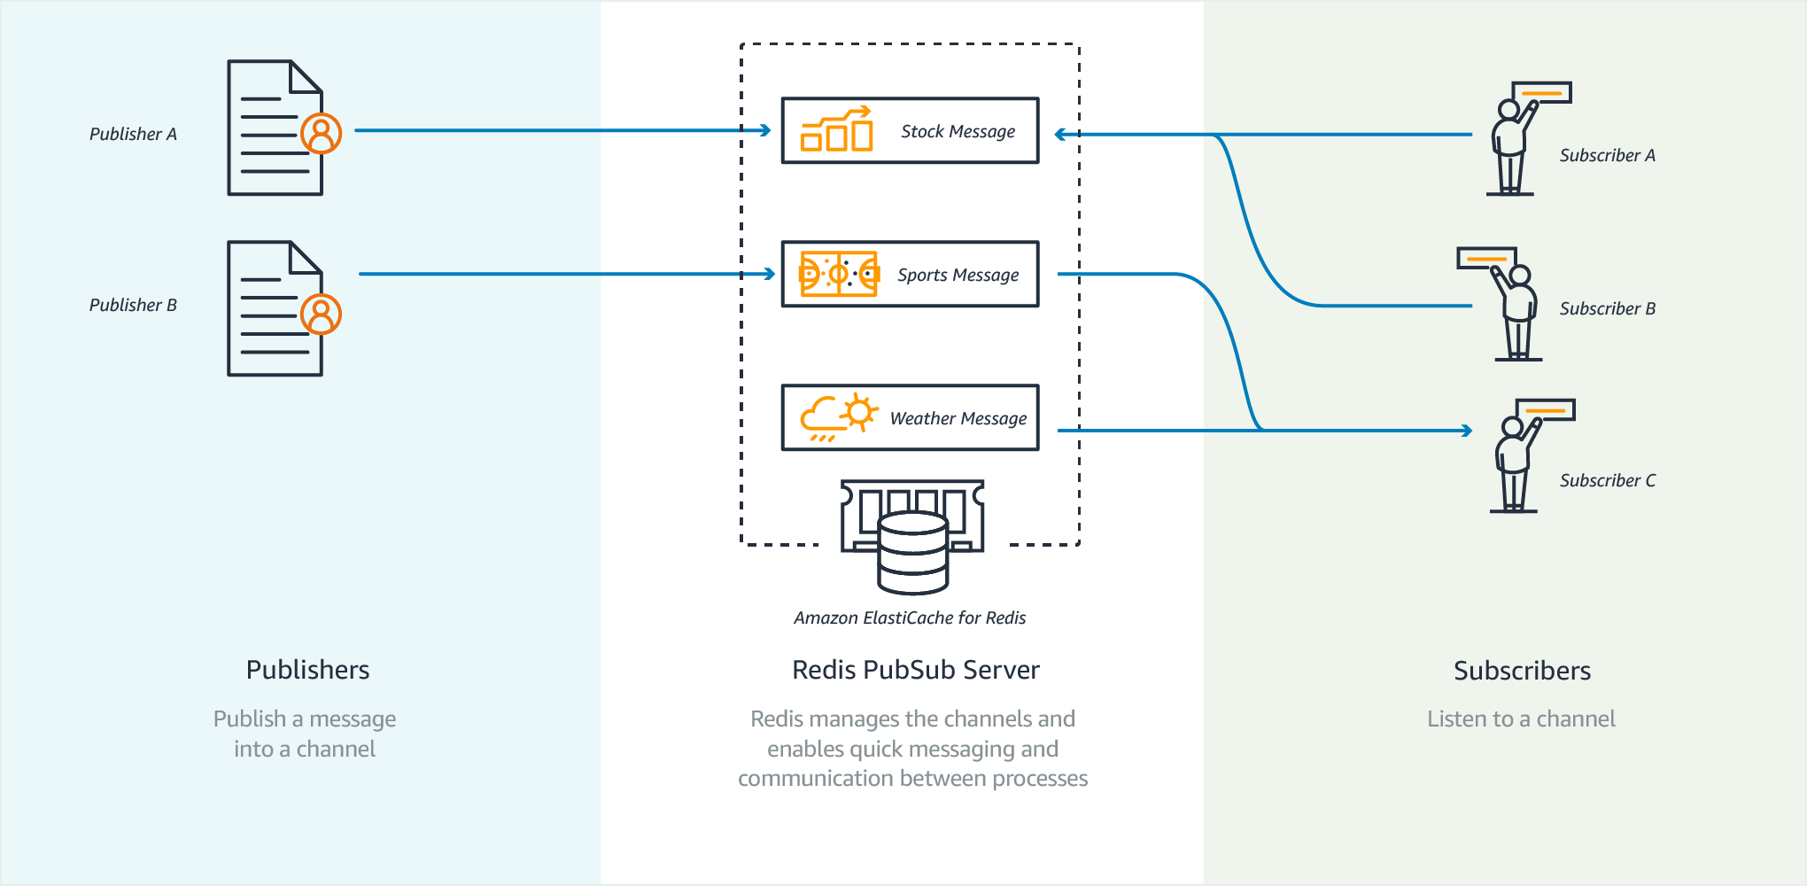
1. Redis
Message Breaker

Slide 7
1. Redis
Blazingly fast
NoSQL
Supported by most languages
https://redis.io/clients
Simple commands
https://divinglaravel.com/redis/redis-commands

Slide 8
2. NodeJS
JavaScript runtime built on Chrome’s V8 JavaScript engine
Event-driven, non-blocking I/O model → Lightweight and efficient
Use npm, is the largest ecosystem of open source libraries in the world

Slide 9
2. NodeJS
Chrome’s V8 JavaScript engine
JavaScript -> V8(C++) -> Machine Code
Event: Something that has happened in our app that we can respond to
System Event
Custom Event

Slide 10
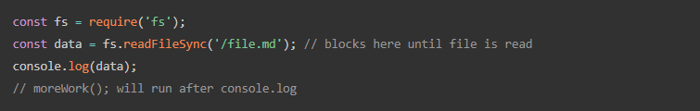
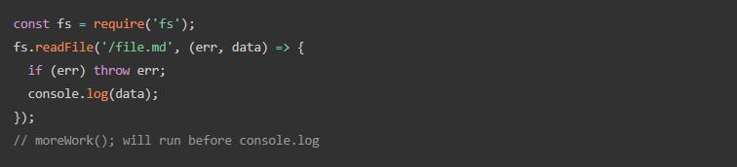
2. NodeJS
Blocking I/O
Non-blocking I/O

Slide 11
3. Socket.IO
JavaScript library for web applications
Real-time, bi-directional communication
Client-side, Server-side
Primarily uses the WebSocket protocol

Slide 12
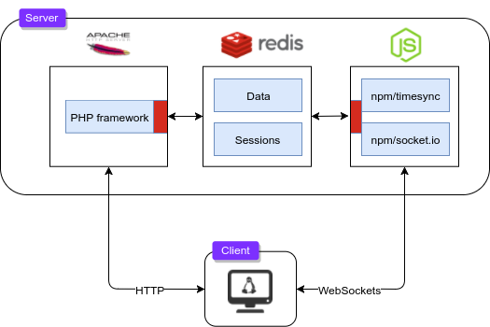
II. Real-time Chatting
6379
6379
80
8890

Slide 13
1. Prepare environment
Create new project
composer create-project --prefer-dist laravel/laravel chat
Generate key
php artisan key:generate
Install Redis for Laravel
composer.json → "predis/predis": "~1.1.1“
composer update

Slide 14
1. Prepare environment
Install NodeJS
https://nodejs.org/en/download/
Install NodeJS packages
npm install express socket.io redis -save

Slide 15
1. Prepare environment
Install Redis for Window
https://github.com/MSOpenTech/redis/releases/download/win-3.2.100/Redis-x64-3.2.100.msi

Slide 16
1. Prepare environment
Download socket.io.js
https://cdnjs.cloudflare.com/ajax/libs/socket.io/2.1.1/socket.io.js
Download Jquery
https://code.jquery.com/jquery-1.11.2.min.js

Slide 17
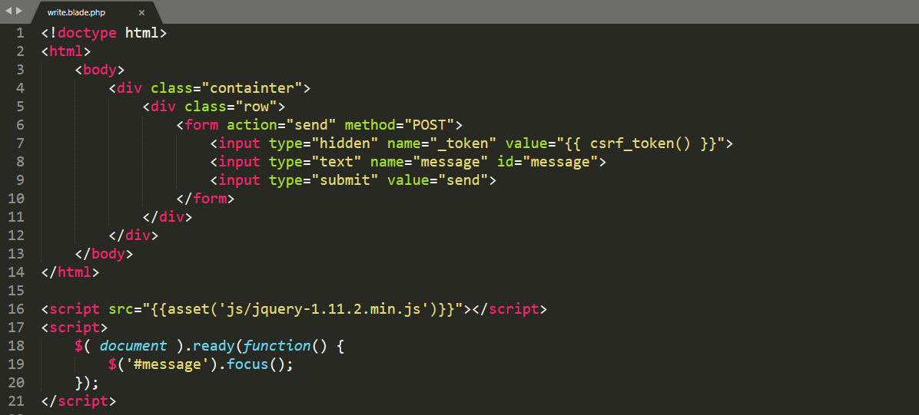
2. Implementation
resources\views\write.blade.php

Slide 18
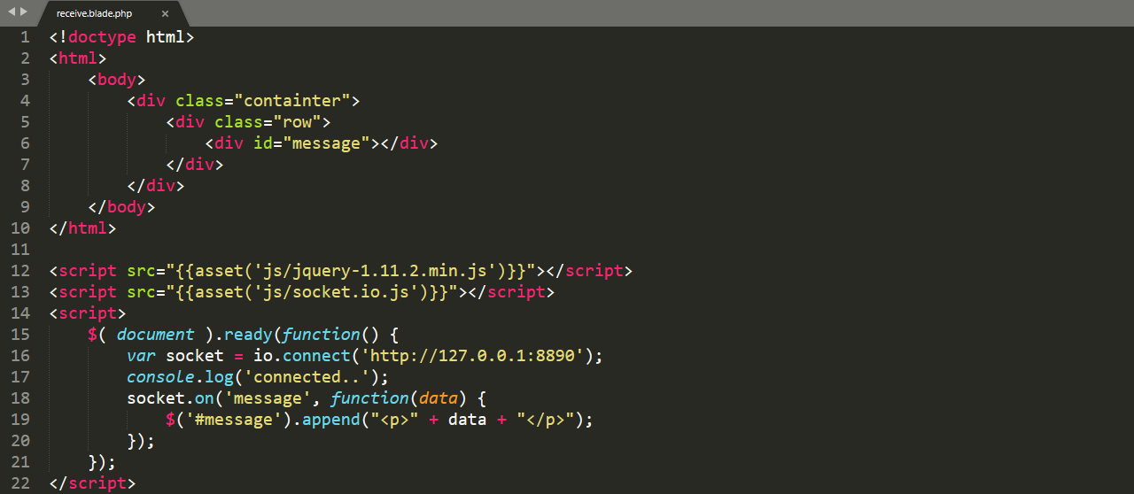
2. Implementation
resources\views\receive.blade.php

Slide 19
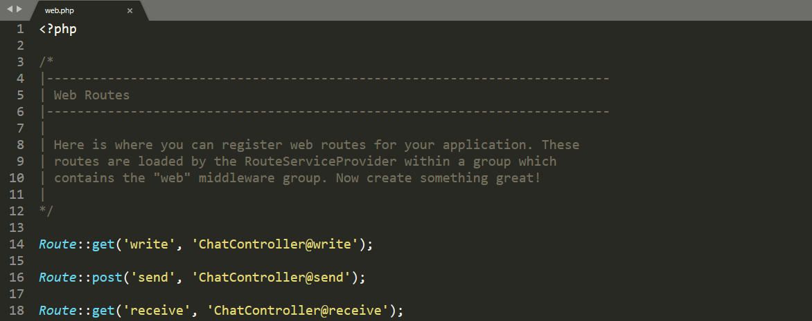
2. Implementation
routes\web.php

Slide 20
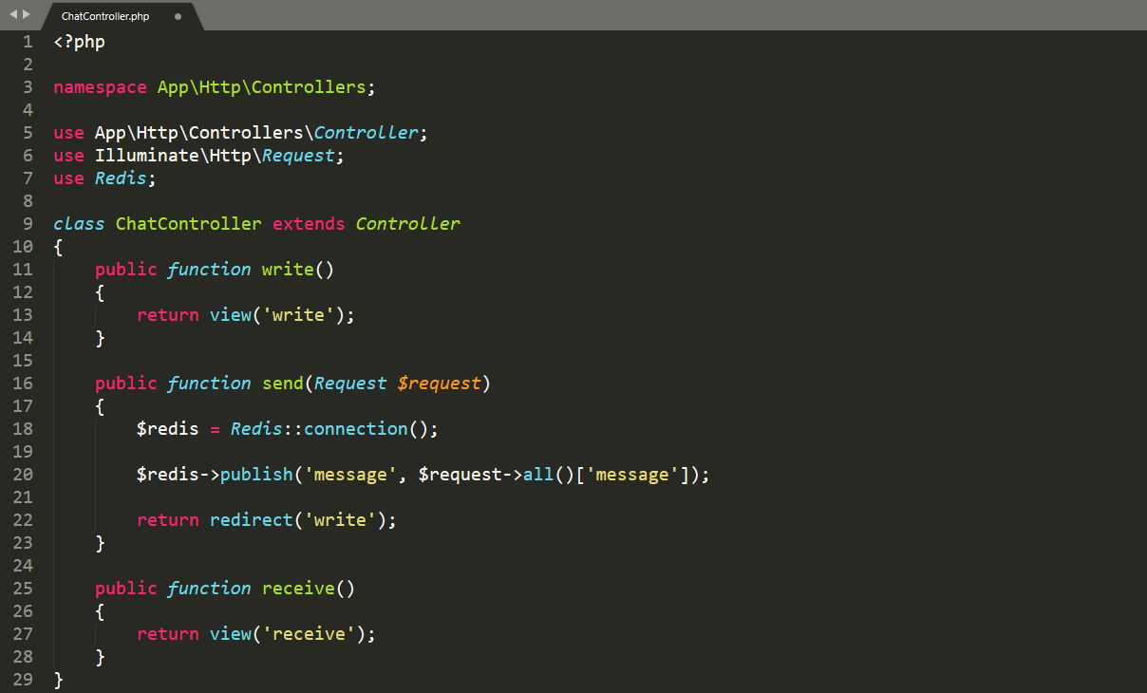
2. Implementation
app\Http\Controllers\ChatController.php

Slide 21
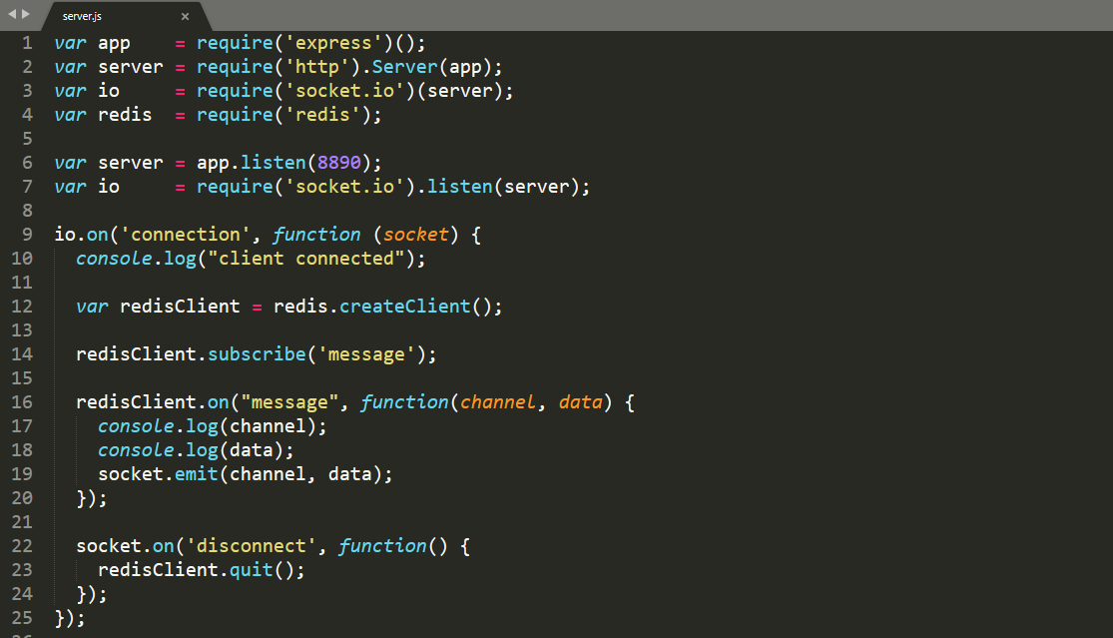
2. Implementation
public\js\server.js

Slide 22
2. Implementation
Start Redis
C:\Program Files\Redis\redis-server.exe
Start Nodejs server
node server.js
Start Apache server
php artisan serve

Slide 23
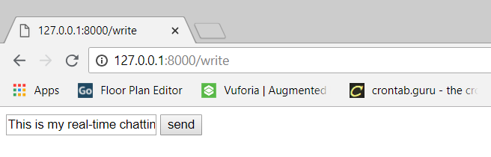
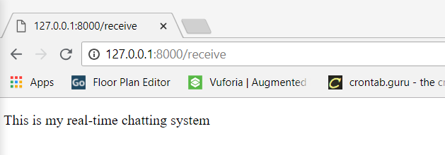
2. Implementation

